Slide 1

Arithmetic Pipeline and
Computer Organization and Architecture | Hardwired and Microprogrammed Control
Course: Computer Organization and Architecture | Chapter: Hardwired and Microprogrammed Control | Program: Bachelor of Engineering
DISCOVER · LEARN · EMPOWER
Notes:
Welcome everyone to today's lecture on Arithmetic Pipelines. We are focusing on this specific topic within the broader context of Hardwired and Microprogrammed Control units. This session is designed to help you evaluate how pipelining impacts control unit performance in arithmetic operations.

Slide 2
Course Outcomes
SLIDE 2 / 10
Course Outcome
CO | BT LEVEL | DESCRIPTION
CO1 | BT3 | Apply number systems and digital logic to design basic digital circuits
CO2 | BT4 | Analyze register organization and instruction set architecture
CO3 | BT3 | Implement computer arithmetic algorithms and floating-point operations
CO4 | BT5 | Analyze memory hierarchy and input-output organization
CO5 | BT6 | Evaluate control unit design and pipelining performance
Chandigarh University
2 / 10
Notes:
Today's lecture directly addresses Course Outcome 5. You will learn to evaluate how control unit designs handle arithmetic operations through pipelining. This involves analyzing performance metrics and design trade-offs in modern processors.

Slide 3
Learning Objectives
SLIDE 3 / 10
Learning Outcomes
1
Define arithmetic pipelines and their role in control unit efficiency.
2
Analyze the impact of pipeline stages on instruction throughput.
3
Evaluate hazards that disrupt arithmetic pipeline flow and performance.
4
Calculate speedup factors for pipelined versus non-pipelined systems.
5
Design control logic to mitigate data dependencies in arithmetic units.
Chandigarh University
3 / 10
Notes:
By the end of this session, you will be able to define arithmetic pipelines and analyze their impact on throughput. We will evaluate specific hazards like data dependencies that can stall the pipeline. Finally, you will calculate speedup factors to quantify performance improvements.

Slide 4
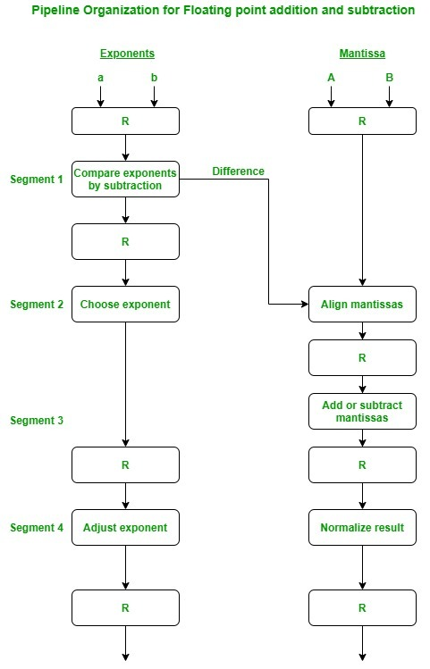
Lecture
SLIDE 4 / 10
Arithmetic Pipeline Definition
1
An arithmetic pipeline divides a complex operation into sequential sub-operations.
2
Each sub-operation is performed by a dedicated functional unit in parallel.
3
The control unit manages data flow between these distinct pipeline stages.
4
This structure allows multiple arithmetic operations to be processed simultaneously.
5
It significantly increases the throughput of the processor compared to serial execution.
Arithmetic Pipeline and Instruction Pipeline - GeeksforGeeks
Chandigarh University
4 / 10
Notes:
Think of an arithmetic pipeline like an assembly line for calculations. Instead of one worker doing the entire multiplication, four workers each handle a specific step. The control unit ensures data moves smoothly from one stage to the next without bottlenecks.

Slide 5
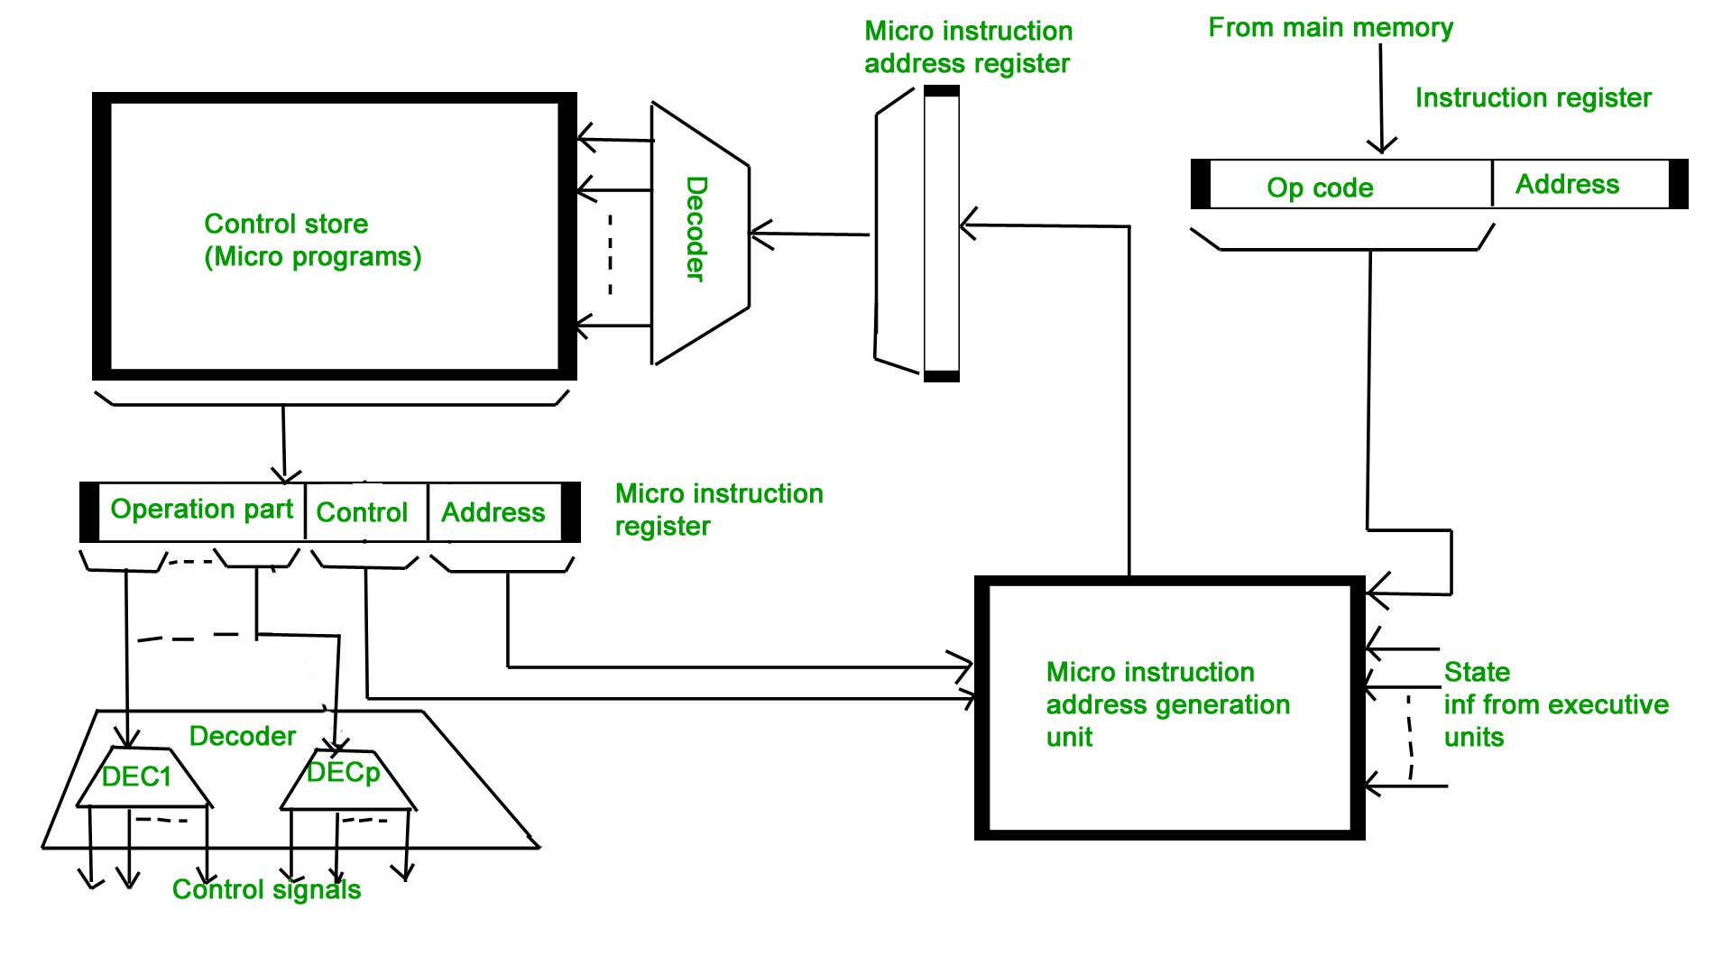
Lecture
SLIDE 5 / 10
Pipeline Stages and Control
1
A typical 4-stage pipeline includes Fetch, Decode, Execute, and Write-back.
2
The control unit generates signals to activate specific functional units per stage.
3
Hardwired control uses logic gates for fast, fixed-stage timing sequences.
4
Microprogrammed control uses stored sequences for flexible, complex stage management.
5
Both methods aim to minimize idle time in the arithmetic pipeline stages.
Hardwired and Micro-programmed Control Unit - GeeksforGeeks (source: www.geeksforgeeks.org)
Chandigarh University
5 / 10
Notes:
The control unit is the brain that coordinates these stages. In hardwired control, logic gates generate signals instantly for fixed operations. In microprogrammed control, a sequence of micro-instructions manages the flow, offering flexibility for complex arithmetic instructions.

Slide 6
Lecture
SLIDE 6 / 10
Pipeline Hazards and Risks
1
Structural hazards occur when hardware resources are insufficient for concurrent use.
2
Data hazards arise when an instruction depends on the result of a previous one.
3
Control hazards happen when the pipeline flow is disrupted by branch instructions.
4
The control unit must detect and resolve these hazards to maintain performance.
5
Ignoring hazards leads to pipeline stalls and reduced overall throughput efficiency.
Arithmetic Pipeline and Instruction Pipeline - GeeksforGeeks (source: media.geeksforgeeks.org)
Chandigarh University
6 / 10
Notes:
Hazards are the biggest challenge in pipelining. For example, if you need the result of a division to start a multiplication, you face a data hazard. The control unit must detect this and stall the pipeline or use forwarding to resolve it.

Slide 7
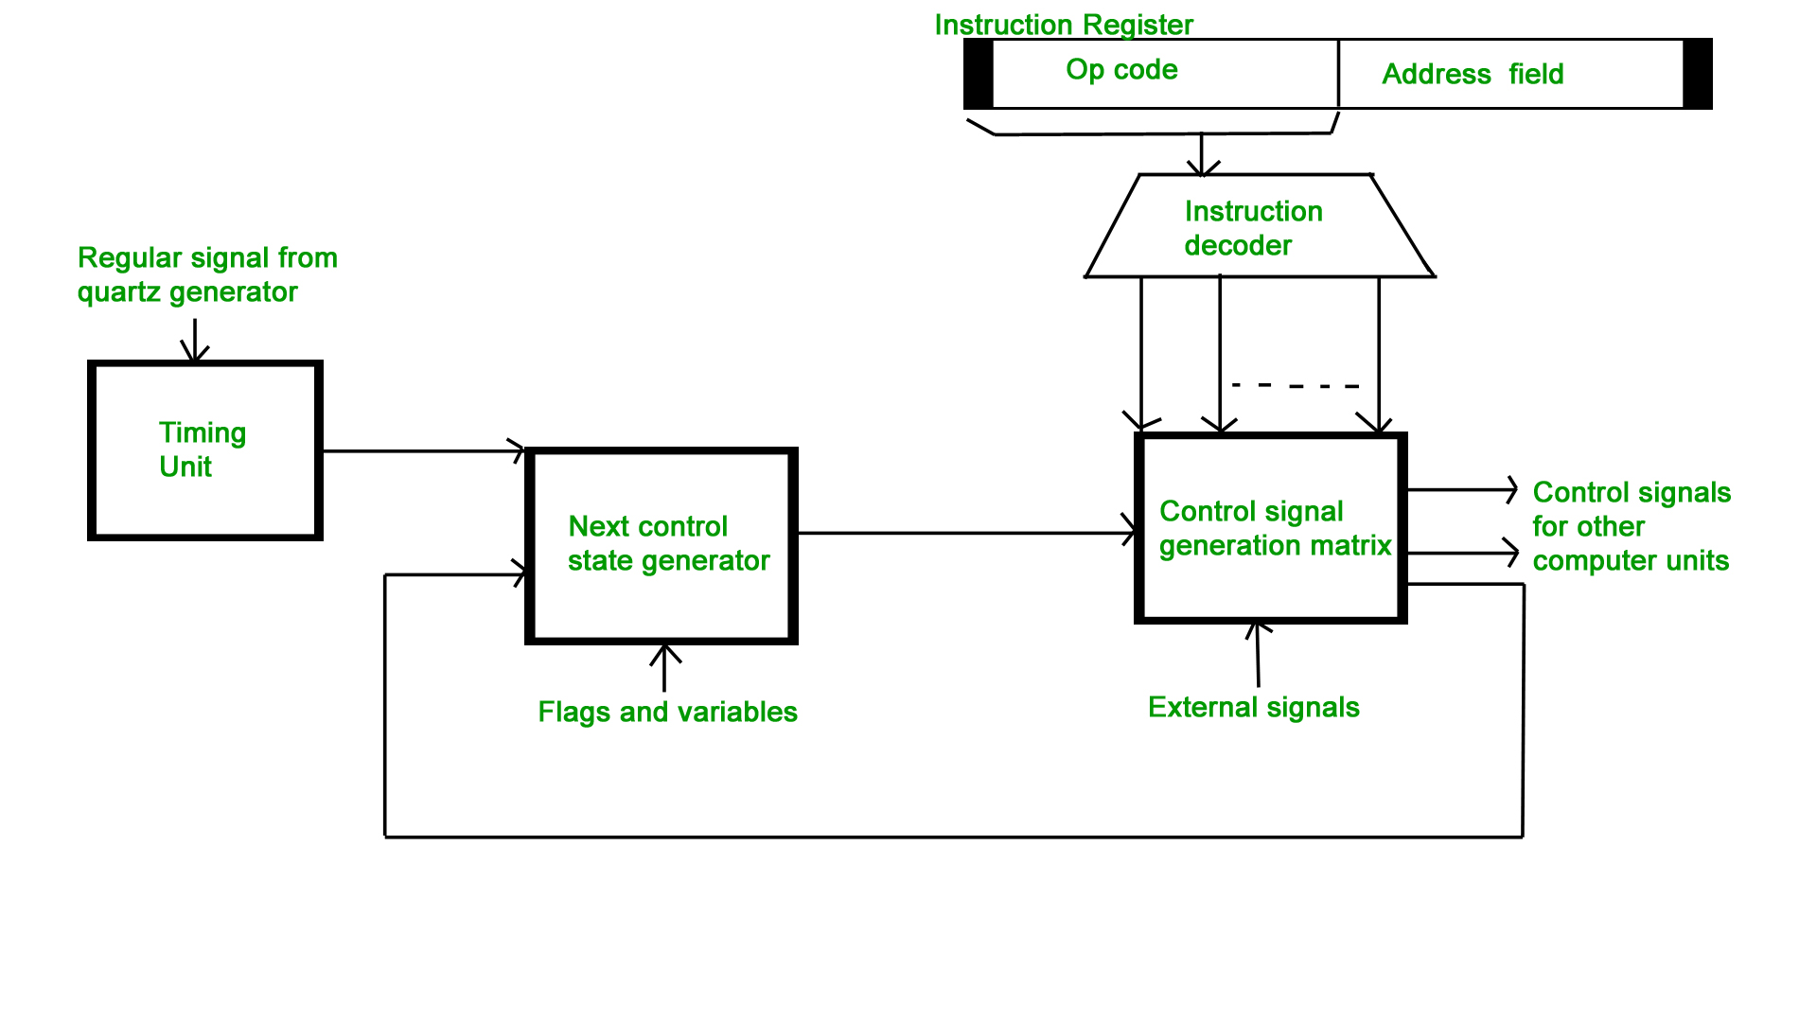
Lecture
SLIDE 7 / 10
Speedup Calculation Example
GOVERNING EQUATION
Speedup = (Time for non-pipelined) / (Time for pipelined)
1
Assume a 4-stage pipeline where each stage takes 10 nanoseconds.
2
Non-pipelined execution time for one operation is 40 nanoseconds.
3
Pipelined execution time for one operation is 10 nanoseconds after startup.
4
Theoretical maximum speedup for 4 stages is 4 × faster than serial.
Hardwired and Micro-programmed Control Unit - GeeksforGeeks (source: www.geeksforgeeks.org)
Chandigarh University
7 / 10
Notes:
Let's do a quick calculation. If one operation takes 40 nanoseconds serially, a 4-stage pipeline can theoretically complete one operation every 10 nanoseconds once full. This gives us a theoretical speedup of 4, meaning the processor is four × faster.

Slide 8
Lecture
SLIDE 8 / 10
Performance Evaluation Metrics
1
Throughput measures the number of operations completed per unit of time.
2
Latency is the total time taken for a single operation to complete.
3
Efficiency is the ratio of actual speedup to the theoretical maximum speedup.
4
Control unit design directly impacts the efficiency of the arithmetic pipeline.
5
Optimizing control signals reduces overhead and maximizes pipeline utilization rates.
Hardwired and Micro-programmed Control Unit - GeeksforGeeks (source: www.geeksforgeeks.org)
Chandigarh University
8 / 10
Notes:
When evaluating performance, we look at throughput and latency. Throughput tells us how many operations we finish per second, while latency is how long one takes. Efficiency tells us how close we are to the theoretical maximum, which depends heavily on our control unit design.

Slide 9
Lecture
SLIDE 9 / 10
Key Takeaways
1
Arithmetic pipelines divide operations into parallel stages for higher throughput.
2
Control units manage data flow and resolve hazards in the pipeline.
3
Hardwired control offers speed, while microprogrammed control offers flexibility.
4
Hazards like data dependencies can stall the pipeline and reduce performance.
5
Speedup is calculated by comparing pipelined and non-pipelined execution ×.
Source: www.geeksforgeeks.org
Chandigarh University
9 / 10
Notes:
To summarize, arithmetic pipelines boost performance by parallelizing operations. The control unit is critical for managing these stages and resolving hazards. Remember that while hardwired control is fast, microprogrammed control offers the flexibility needed for complex arithmetic instructions.

Slide 10
Lecture
SLIDE 10 / 10
References
COMPUTER ORGANIZATION AND DESIGN
The Hardware/Software Interface — David A. Patterson, John L. Hennessy
COMPUTER ARCHITECTURE
A Quantitative Approach — John L. Hennessy, David A. Patterson
• Computer Organization and Architecture — William Stallings
• Computer System Architecture — M. Morris Mano & Rajib Mall
• Computer Organization — Carl Hamacher, Zvonko Vranesic, Safwat Zaky
Chandigarh University
10 / 10
Notes:
These five textbooks provide the foundational knowledge for today's lecture. I encourage you to read the chapters on pipelining and control units in Stallings and Hennessy for deeper insights. They offer excellent examples and quantitative approaches to understanding these concepts.

